Slide 1

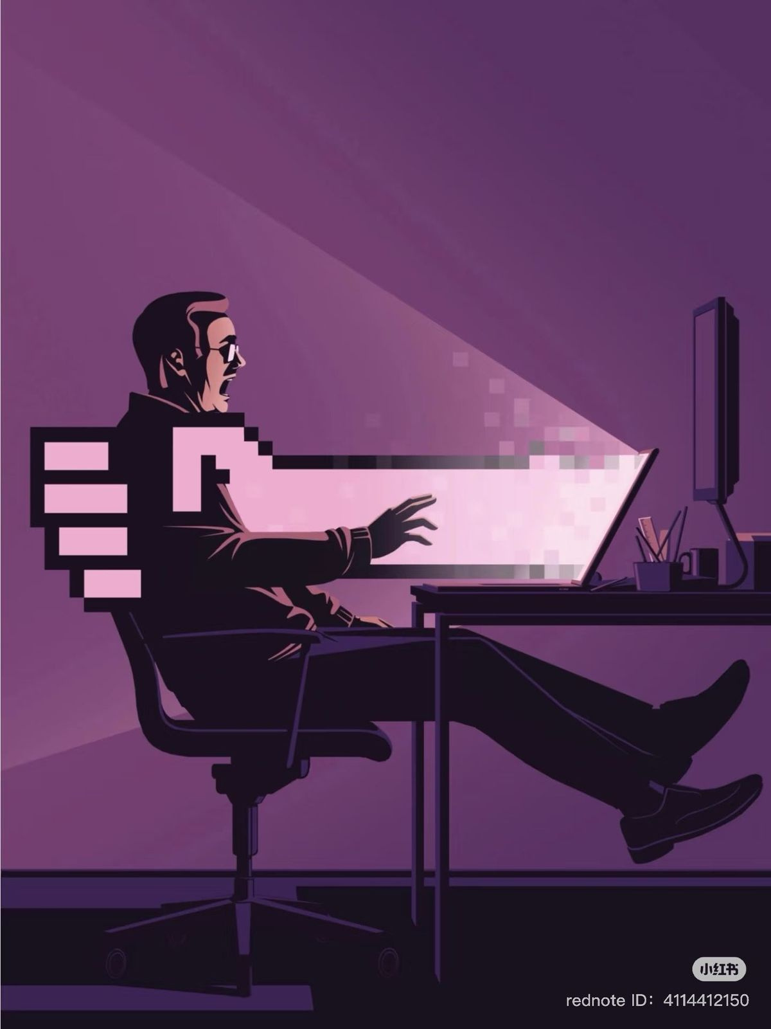
Cyber attack
By: Sara Hatem
Shaza Muhmad
Rawda Ayman
Omar Adl
Mostafa Hossam

Slide 2
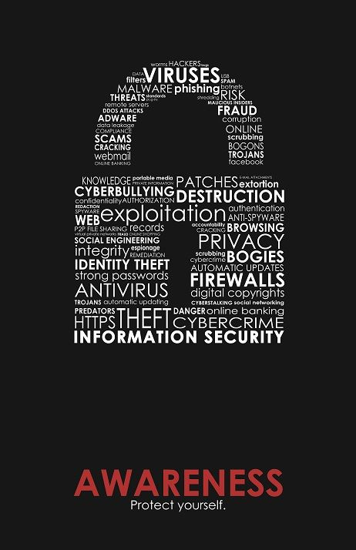

Network security
Network security is as important as your house’s doors and locks.
No network security , then no privacy , more stealing, and more threatening.
2

Slide 3

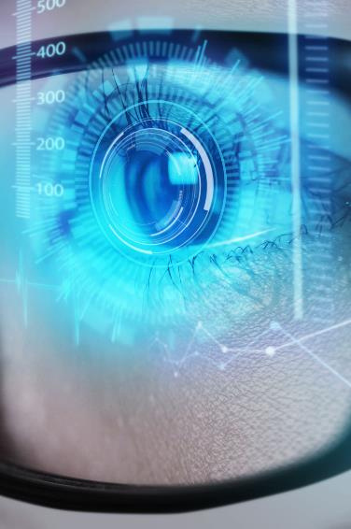
Problem
attacks
Weak security
Bad maintaining
Whenever the security get stronger ,on the other side hackers find new techniques to attack your privacy
Weak security cause easier access and attacks
user wasn’t keeping the actual hardware safe
Costs
Usability
High security is expensive
When using weak security passwords or trust unknown websites
3

Slide 4





CIA Triad
Confidentiality
Integrity
Availability
Keep data private and safe
Only authorized person can view
Protect data from being modified by unauthorized people
Protect data in case of motion and keep it accurate
- Data always available
4
Notes:
4

Slide 5

Confidentiality
Integrity
Encryption
Strong authentication
Biometric authentication
Data hashing
Data backups
Enforced permissions
Monitor file changes
Use power supplies
Solution
Availability
Data redundancy
Data backup
Disaster recovery
5

Slide 6

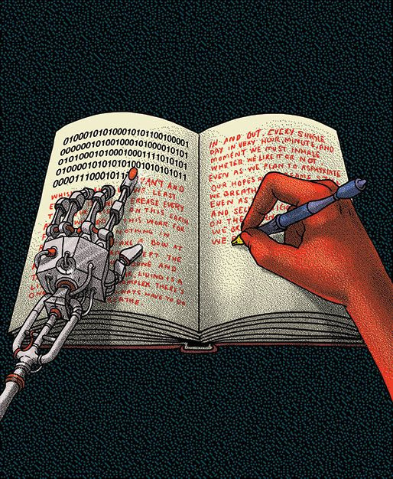
Security components
Firewall
IDS/IPS
VPNs
Encryption
access control
6

Slide 7
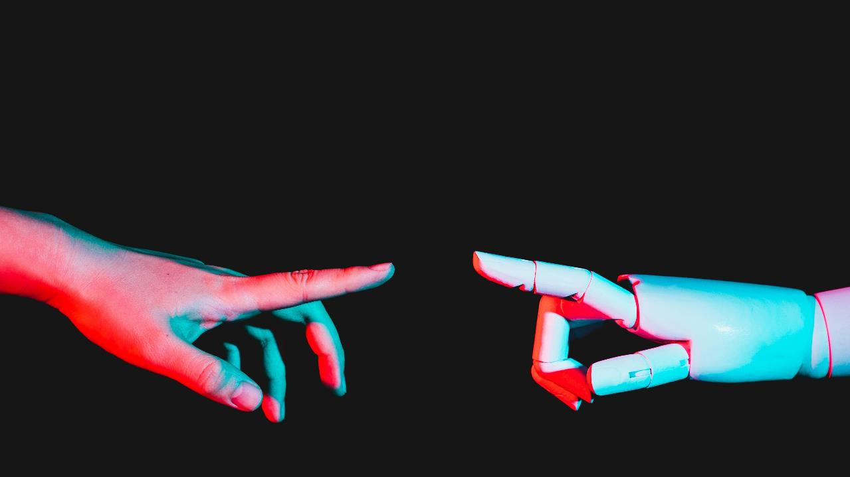
Company overview

Slide 8

Business Model
Research​
We based our research on market trends and software sales ​
Abstract​
We believe people need new management tools to help businesses achieve their OKRs​
Design​
Minimalist design and easy to use ​
8/06/20XX
PITCH DECK
8

Slide 9

Market overview
$3B
$2B
$1B
Opportunity to build​
Fully inclusive market​
Total addressable market​
Freedom to invent​
Selectively inclusive market​
Serviceable available market​
​
Few competitors​
Specifically targeted market​
Serviceable obtainable market​
​
8/06/20XX
PITCH DECK
9

Slide 10

Market Comparison
Opportunity to build​
Fully inclusive market​
Total addressable market​
Freedom to invent​
Selectively inclusive market​
Serviceable available market​
​
Few competitors​
Specifically targeted market​
Serviceable obtainable market​
​
8/06/20XX
PITCH DECK
10

Slide 11
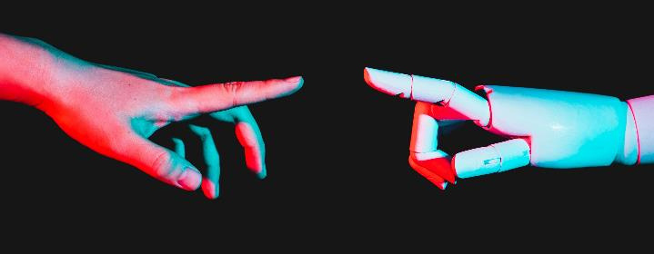
Our competition
Contoso​
Competitors​
Our product is priced below that of other task management tools on the market​
Simple and easy to use app and website, compared to the complex tools of our competitors​
Affordability is the main draw for our consumers to our product​
Company A​
Product is more expensive​
Companies B & C ​
Product is expensive and inconvenient to use​
Companies D & E​
Product is affordable, but inconvenient to use
8/06/20XX
PITCH DECK
11

Slide 12

competition
Convenient
Contoso
A
Expensive​
Affordable
B
D
E
C
Inconvenient​
8/06/20XX
PITCH DECK
12

Slide 13
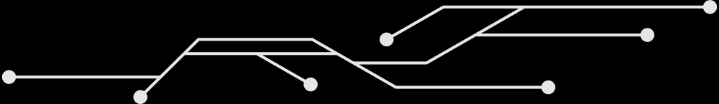
CASE STUDY
WANNACRY RANSOMWARE ATTACK (2017)
On May 12, 2017 , a massive ransomeware outbreak spread worldwide
Exploited a known Windows vulnerability (EternalBlue / SMBv1)
Altough Microsoft had released a patch two months earlier , many organsizations hadn’t applied it
The ransomeware encrypted files and demanded payment in Bitcoin to unlock them
13

Slide 14
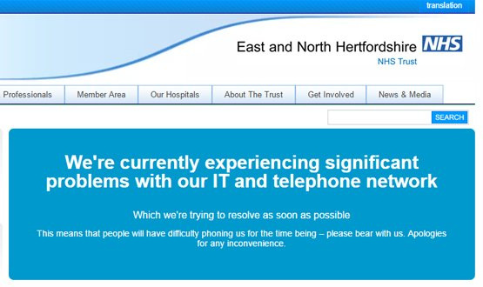
SCALE AND IMPACT
200,000+ systems infected across 150+ countries within days
Victims included large enterprises, hostpitals, small businesses , and individuals
High-profile disruption:
UK National Health Service (NHS) : hospitals shut down, surgeries cancelled
FedEx, Telefonica, Deutshe Bahn also impacted
Estimated global finanical damage: $4-8 billion
14

Slide 15
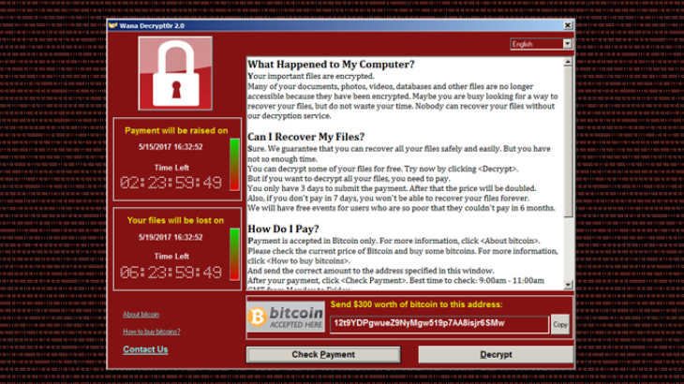
InfeCTION METHOD & VICTIM EXPERIENCE
Likely infection paths:
Phishing emails with malicious attachments
Exposed SMB port (445) on unpatched systems
Victim Experience:
Files encrypted with “.wncry” extension
Ransom note demanding $300 in Bitcoin , doubling after 3 days
THREAT
files permanently lost after 7 days
Installed DoublePulsar backdoor → left systems vulnerable even after removal
15

Slide 16
COnTAINMENT AND MITIGATION
Kill Switch Discovery : security researcher found a “kill switch” domain registering it slowed global spread
Mitigation strategies implemented:
Apply Microsoft MS17-010 patch
Block port 445 at network permiter + disable SMBv1
Segment networks to prevent lateral spread
Deploy anti-malware detection tools
Limitations:
Removal tools could clean malware but could not decrypt files
Some variants appeared without the kill switch
16

Slide 17
LESSONS LEARNED
Patch Management is Critical
Attack succeeded mainly because organizations ignored available security updates.
Defense in Layers
Firewalls, IDS/IPS, backups, and network segmentation must work together.
Human Factor
Security awareness to spot phishing and avoid risky behaviors.
Ransom is No Guarantee
Very few victims - confirmed data recovery after paying.
WannaCry proved that cybersecurity is a continuous process, requiring technology, policy, and awareness.
17

Slide 18
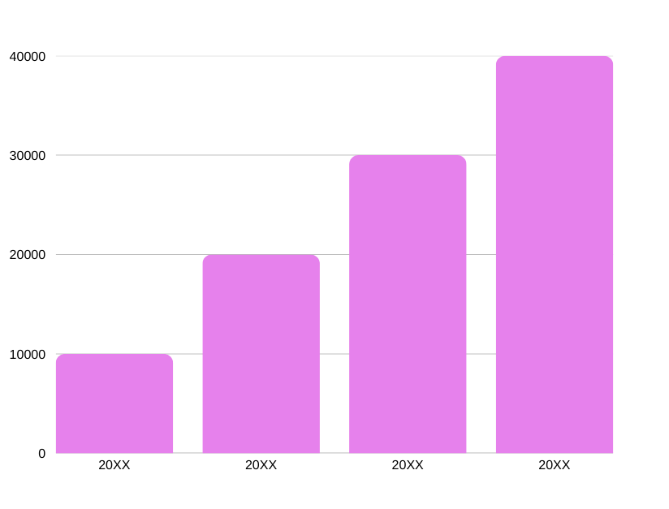
Traction
Forecasting for success​
Key Metrics
Revenue by year
 | clients | orders | Gross avenue | Net revenue
20XX​ | 10​ | 1100​ | $10,000​ | $7,000​
20XX​ | 20​ | 200​ | $20,000​ | $16,000​
20XX​ | 30​ | 300​ | $30,000​ | $25,000​
20XX​ | 40​ | 400​ | $40,000​ | $30,000
15

Slide 19

Two-year action plan
Supply volunteers​
Run focus groups​
Gather feedback​
20XX
Jan
Feb
Mar
Apr
May
Jun
Jul
Aug
Sep
Oct
Nov
Dec
Test with start ups​
Regional launch​
Deliver to consumers​
20XX
Jan
Feb
Mar
Apr
May
Jun
Jul
Aug
Sep
Oct
Nov
Dec
8/06/20XX
PITCH DECK
15

Slide 20

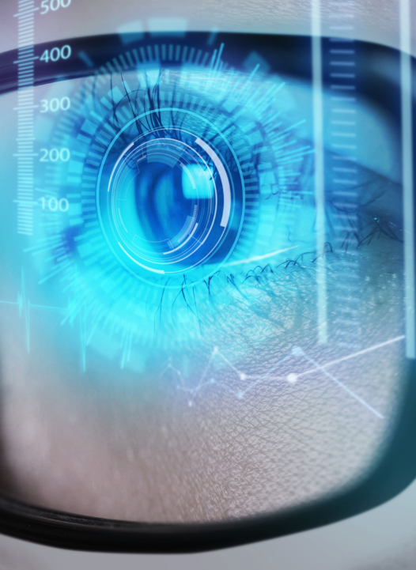
Financials
 | Year 1 | Year 2 | year 3
Detailers​ | 5,000​ | 40,000​ | 160,000​ | ​
Users​ | 50,000​ | 400,000​ | 1,600,000​ | ​
Sales​ | 500,000​ | 4,000,000​ | 16,000,000​ | ​
Average Price per Sale​ | 75​ | 80​ | 90​ | ​
Revenue @ 15%​ | 5,625,000​ | 48,000,000​ | 216,000,000​ | ​
Gross Profit​ | 5,625,000​ | 48,000,000​ | 216,000,000​ | ​
Expenses​ | ​ | ​ | ​ | ​
Sales & Marketing​ | 5,062,500​ | 38,400,000​ | 151,200,000​ | ​
Customer Service​ | 1,687,500​ | 9,600,000​ | 21,600,000​ | 70%​
Product Development​ | 562,500​ | 2,400,000​ | 10,800,000​ | 10%​
Research​ | 281,250​ | 2,400,000​ | 4,320,000​ | 5%​
Total Expenses​ | 7,593,750​ | 52,800,000​ | 187,920,000​ | 2%​
8/06/20XX
PITCH DECK
16

Slide 21

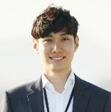
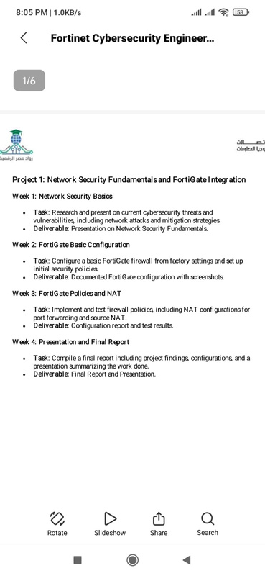
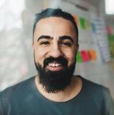
Meet the team
Takuma Hayashi​​
Mirjam Nilsson​​
Flora Berggren​​
Rajesh Santoshi​​
President​
Chief Executive Officer​
Chief Operations Officer​
VP Marketing​
8/06/20XX
PITCH DECK
17

Slide 22




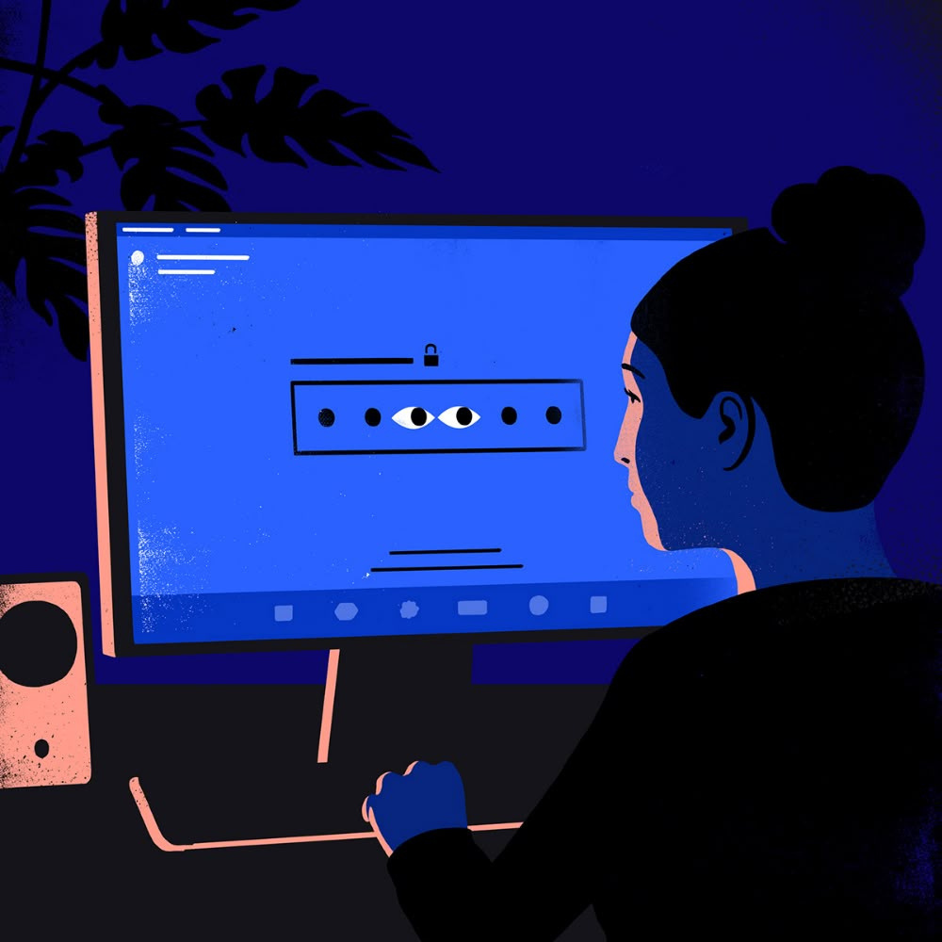
The Full team
Takuma Hayashi​
Mirjam Nilsson​​
Flora Berggren​​
Rajesh Santoshi​​
President​
Chief Executive Officer​
Chief Operations Officer​
VP Marketing​
Graham Barnes​
Rowan Murphy​
Elizabeth Moore​
Robin Kline​
VP Product​
SEO Strategist​
Product Designer​
Content Developer​
8/06/20XX
PITCH DECK
18

Slide 23




Funding
$12K
$14K
$32K
$82K
Campaigns
Angel investments
Cash
Shares
Revenue obtained from online campaigns and reorders
Amount obtained through other investors​
Liquid cash we have
on hand​
Number of shares converted into USD​
8/06/20XX
PITCH DECK
19

Slide 24
Key Takeaways
Strong security requires a balanced approach:
Technology → Firewalls , VPNs , IDS/IPS
Encryption Awareness → User training & phishing prevention
Policy → Clear rules for passwords, updates, and access control
Formula for success:
Technology + Awareness + Policy = Strong Security

Slide 25
SUMMARY
It is important today because of the growth of internet, IoT, and rising cyber threats.
CIA Triad:
Confidentiality → Only authorized access
Integrity → Data remains accurate and unchanged
Availability → Systems always accessible
Key Components: Firewalls, IDS/IPS, VPNs, Encryption, Access Control
Main Threats: Malware (viruses, ransomware, worms), Phishing, DoS/DDoS, Man-in-the-Middle, Insider threats
Vulnerabilities: Weak passwords, unpatched systems, misconfigurations
Countermeasures: Firewalls, updates & patching, MFA, training, encryption
Conclusion: Security is an ongoing process, requiring technology, awareness, and policies
Thank you

